Slide 1
Chapter 2
Information Systems Building Blocks

Slide 2
Information Systems
Front-Office Information System
  business functions supporting customers
Back-Office Information Systems
  business functions supporting suppliers and internal operations

Slide 3
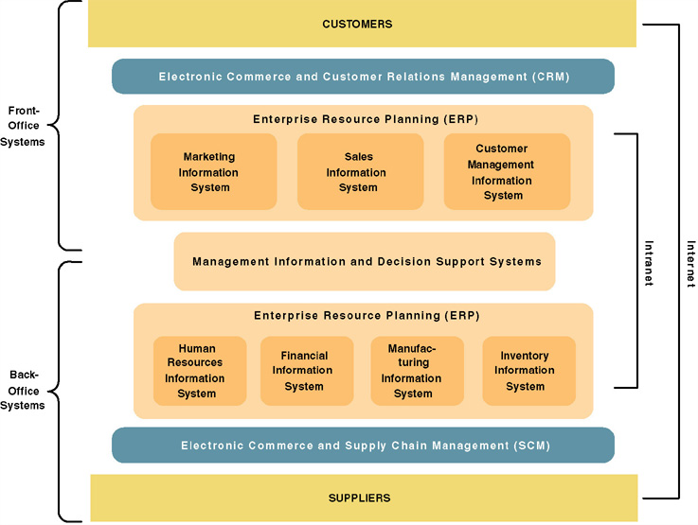
A Federation of Information Systems

Slide 4
Classes of Information Systems
Transaction Processing Systems
Management Information Systems
Executive Information Systems
Decision Support Systems
Expert Systems
Communications & Collaboration System
Office Automation

Slide 5
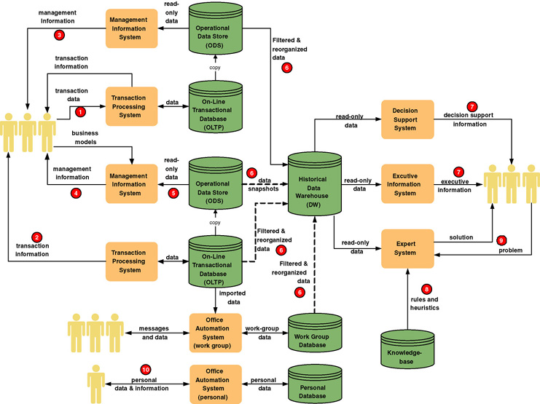
Classes of Information Systems

Slide 6
Information System Architecture
Provides a unifying framework into which various people with different perspectives can organize and view the fundamental building blocks of information systems
Business Knowledge (Data)
Business Processes
Business Communications

Slide 7
FOCUS
 | KNOWLEDGE | PROCESS | COMMUNICATION
OWNER | Business Knowledge | Business Functions | Geographic Locations
USER | Data Requirements | Process Requirements | Business Interface Requirements
DESIGNER | Database Technology | Development Technologies | Interface Specifications
BUILDER | Database Programs SQL | Application Programs | Interface Technology

